Slide 1
Email Security
A secure client for existing email services

Slide 2
Motivation
”When you upload, submit, store, send or receive content to or through our services, you give Google (and those we work with) a world- wide license to use, host, store, reproduce, modify, create derivative works (such as those resulting from translations, adaptations or other changes we make so that your content works better with our services), communicate, publish, publicly perform, publicly display and distribute such content.”
-Google End User License Agreement^{[5]}

Slide 3
Motivation
This means that all your communication is monitored/read by google.
Even if you trust Google (which all of do!), its not safe since it is also shared with companies that collaborate with Google.
It is possible for them to legally steal your ideas and reproduce them.
Bottom line: there’s no privacy from the email service providers. (True for many others along with Google)

Slide 4
Tools Used
JavaMail API from Oracle
Bouncy Castle Library for JAVA
Advance Encryption Standard (AES)
CBC mode of operation
PKCS7 padding
128 bit key
128 bit random IV
RSA Encryption
Block Cipher mode with OAEP
1024 bit keys
PKCS8 encoding for storing

Slide 5
Tools Used
SHA256
128 bit key
Digest size 256 bit
PBKDF2 (Password Based Key Derivation Function)
128 bit random salt
10,000 rounds of operation
Generated key size 128 bit

Slide 6
Solution
Local email client that connects with Gmail for sending receiving email
Securely share public keys via Gmail (Using PBKDF based Symmetric Keys)
Encrypt body of email using session keys
Encrypt session keys using Asymmetric Key Cryptography (RSA)
Send both cipher texts via Gmail
Receiver recovers session keys using his private key
Receiver recovers message using the decoded symmetric key
All communications with Google servers use TLS for security

Slide 7
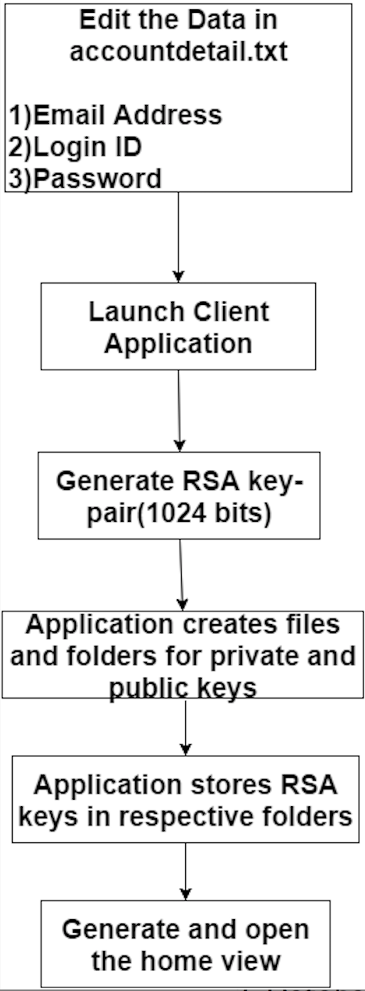
Setup

Slide 8
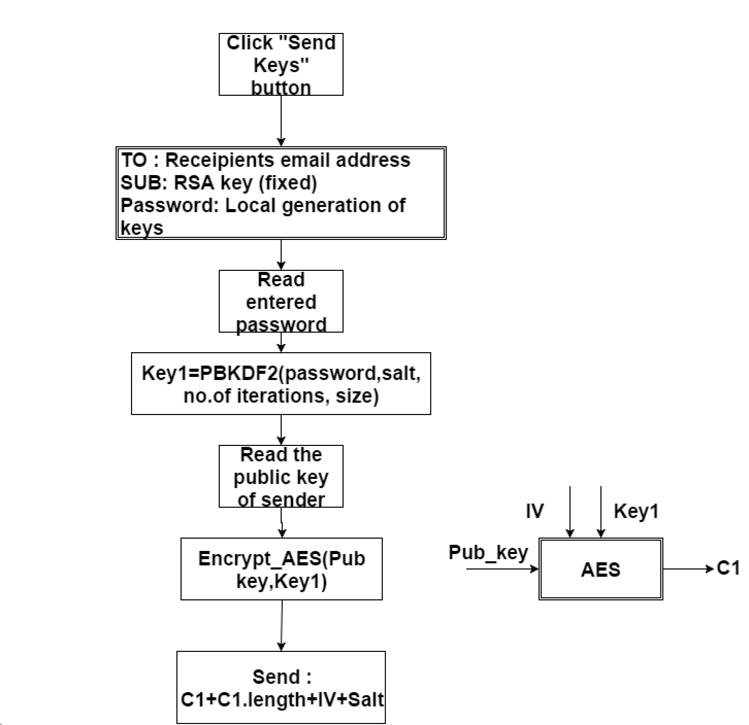
Key Sharing (Send)

Slide 9
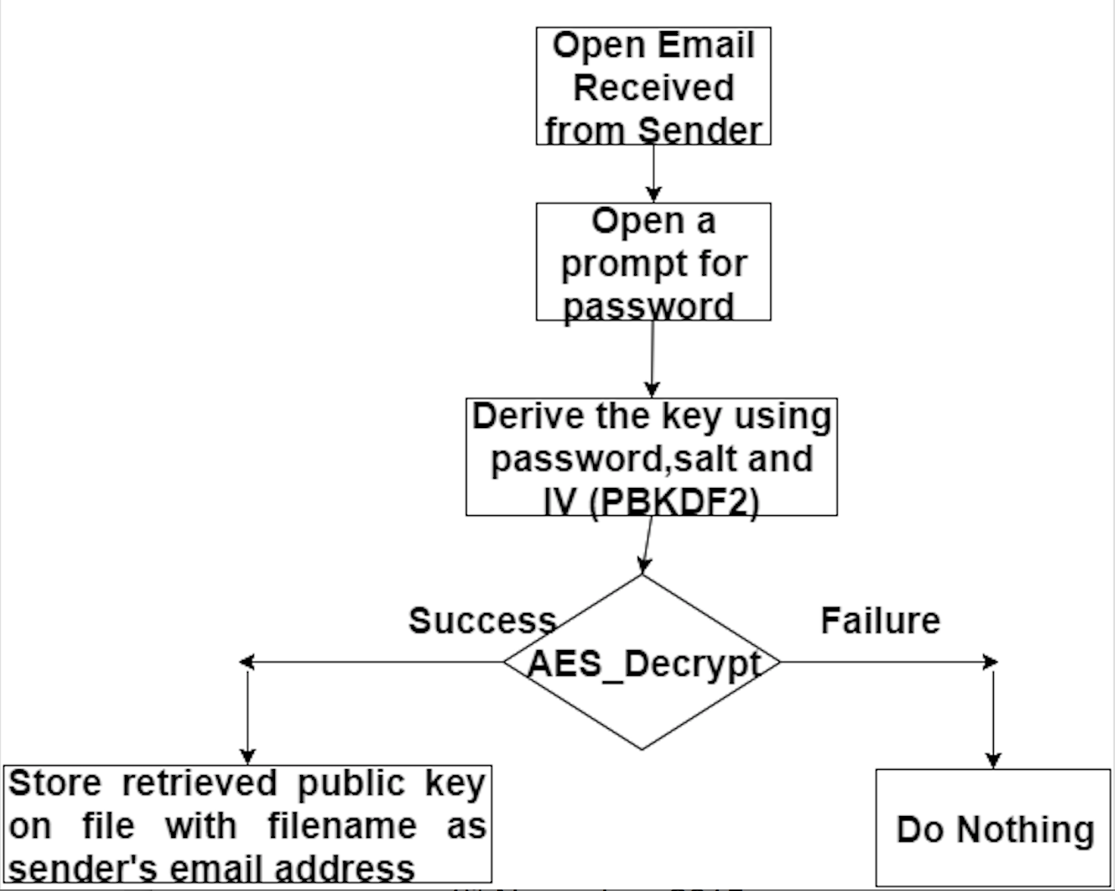
Key Sharing (Receive)

Slide 10
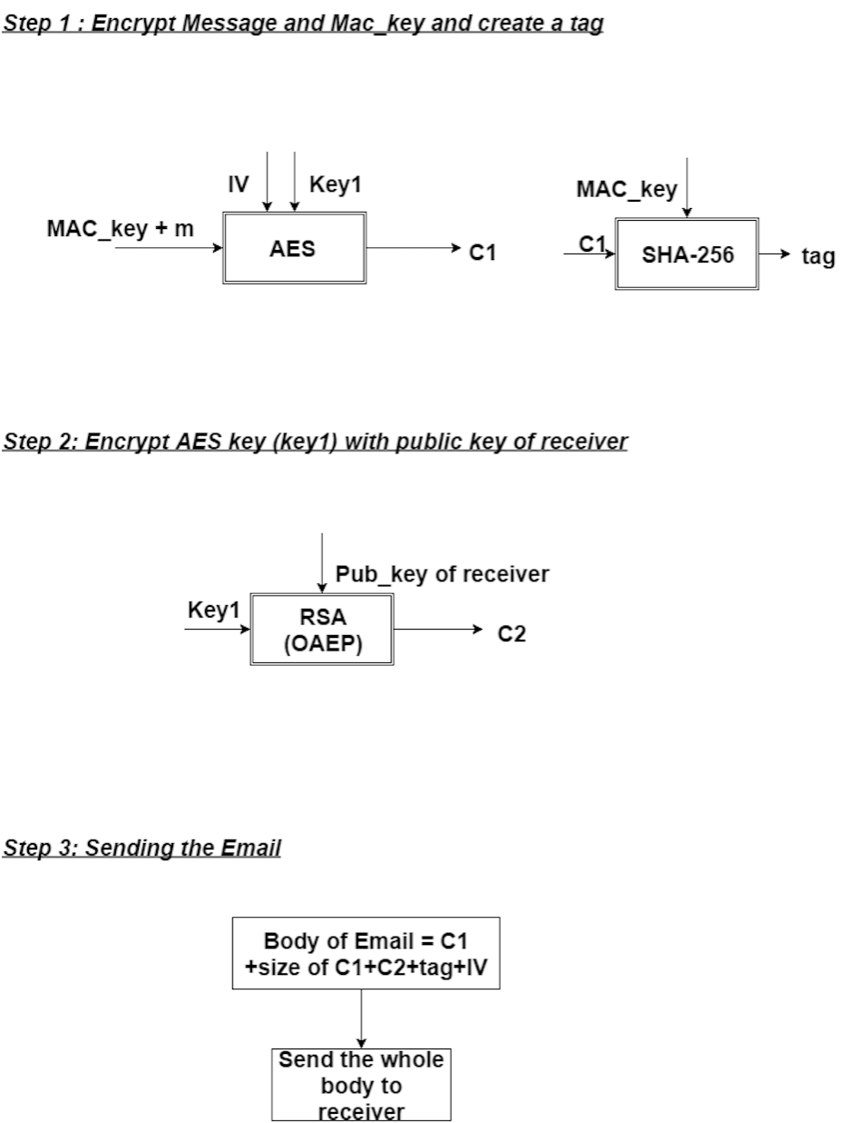
Email (Send)

Slide 11
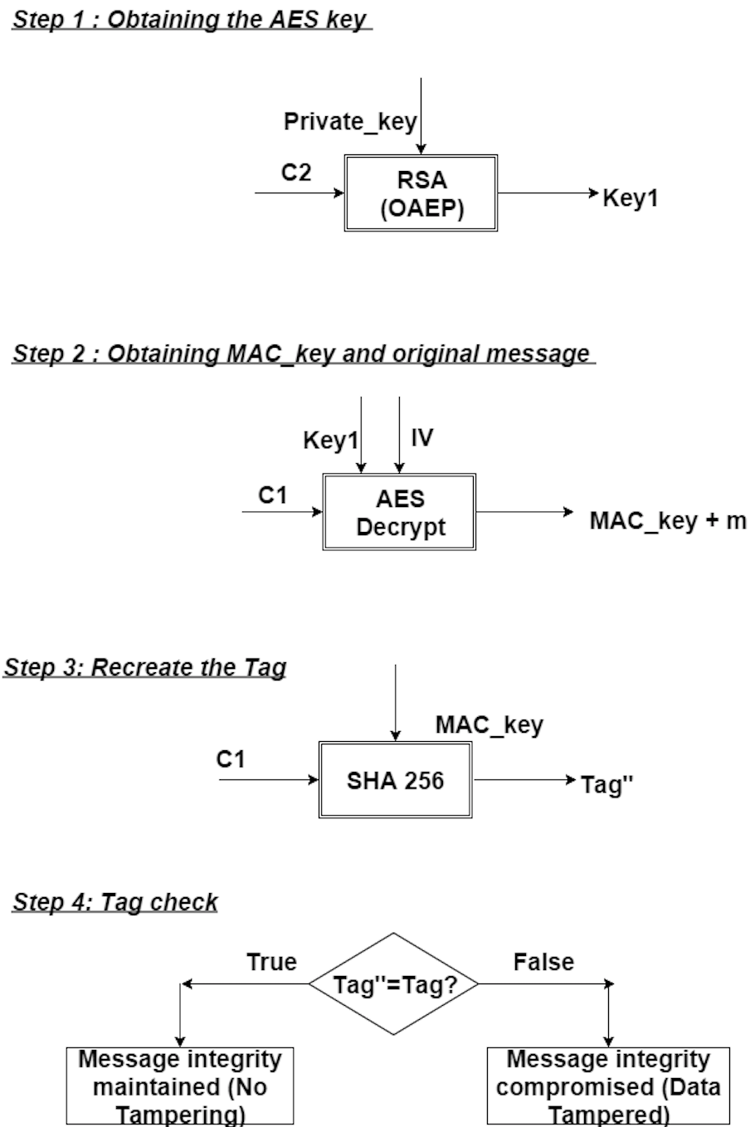
Email (Receive)

Slide 12
Assumptions
Assumes email address of intended recipient to be correct
Assumes File System of the user to be safe (not infected with any malware or virus)
Assumes password will be shared securely
Assumes TLS connection to be a safe mode of communication
Assumes AES in CBC mode to be non-deterministic and secure with 128 bit keys
Assumes RSA with 1024 bit key to be secure
Assumes SHA256 to be collision resistant

Slide 13
Adversarial Model
TLS based connection from User device to Google server provides security against
COA (Eavesdropper)
Known Plain-text attack
Chosen Plain-text attack
Chosen Cipher-text attack
Google as adversary
Has access to cipher text only
Cannot decrypt without private key of receiver
Public key cannot be recovered from cipher-text without password

Slide 14
Possible Attacks
Replay attacks
Google has valid cipher-text of messages on its servers, which can be sent over and over to the recipient
Disruptive attacks
Google can filter all messages that have “RSA Key” as subject (Thus, preventing key exchange from happening)
Google can filter messages based on length (i.e. prevent key exchange messages from reaching the recipient)
Denial of service attack
Google can decide to remove your account or block your IP from accessing their servers

Slide 15
Live Demo!

Slide 16
Conclusion
Implemented Solution is light weight with almost no setup process or learning curve.
Utilizes existing infrastructure such as TLS for communication and Google servers for data storage.
Provides complete privacy from Email service providers when used.
Cross-platform support since entire code base is in Java.
Basically, no more creepy ads about ‘cars’ when you write an email with the word ‘car’ in it.

Slide 17
References
[1] Bouncy Castle http://www.bouncycastle.org
[2] JavaMail API http://www.oracle.com/technetwork/java/javamail/index.html
[3] Stack Overflow http://stackoverflow.com
[4] Crypto and Javahelp subreddits http://reddit.com/r/crypto & http://reddit.com/r/javahelp
[5] Google End User Lisence Agreement http://www.google.com/intl/en/policies/terms/

Slide 18
THANK YOU!
AKASH SINGH | ABHIJEET RANADIVE

